Slide 1


IMDB
MOVIES
Final Project Presentation
Submitted To:
Dr. Rasha Al-bashaireh
1

Slide 2




GROUP# 13
MEMBERS
Ayham Rababaa
Mohmmad AL-Masre
Omar Haymone
Fayez Smeerat
MOVIES
2

Slide 3
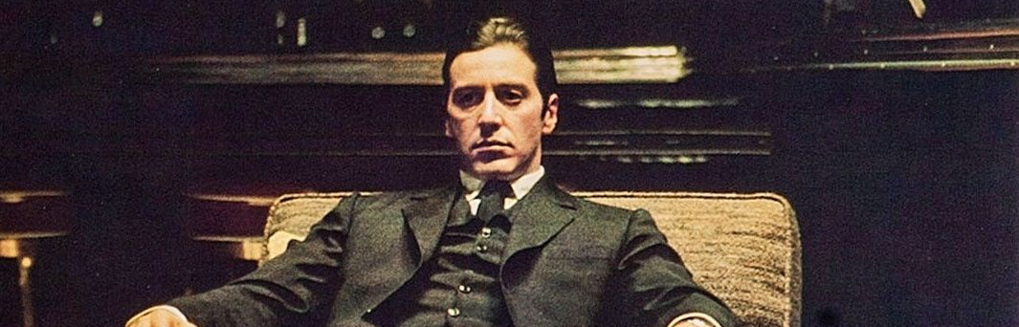

IMDB MOVIES DATASET
Contains information about the highest-rated movies on IMDB. It provides details such as titles, ratings, genres, directors, actors, and other relevant attributes.
MOVIE
3

Slide 4
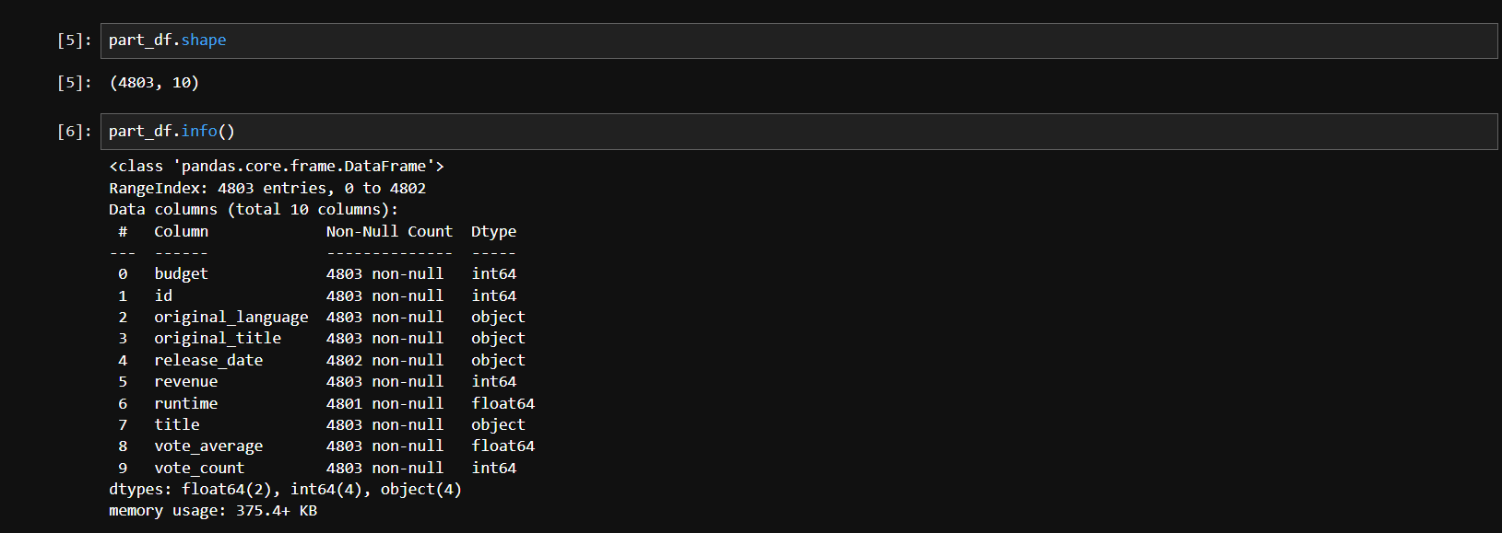
SNAPSHOT 1
MOVIE
4

Slide 5
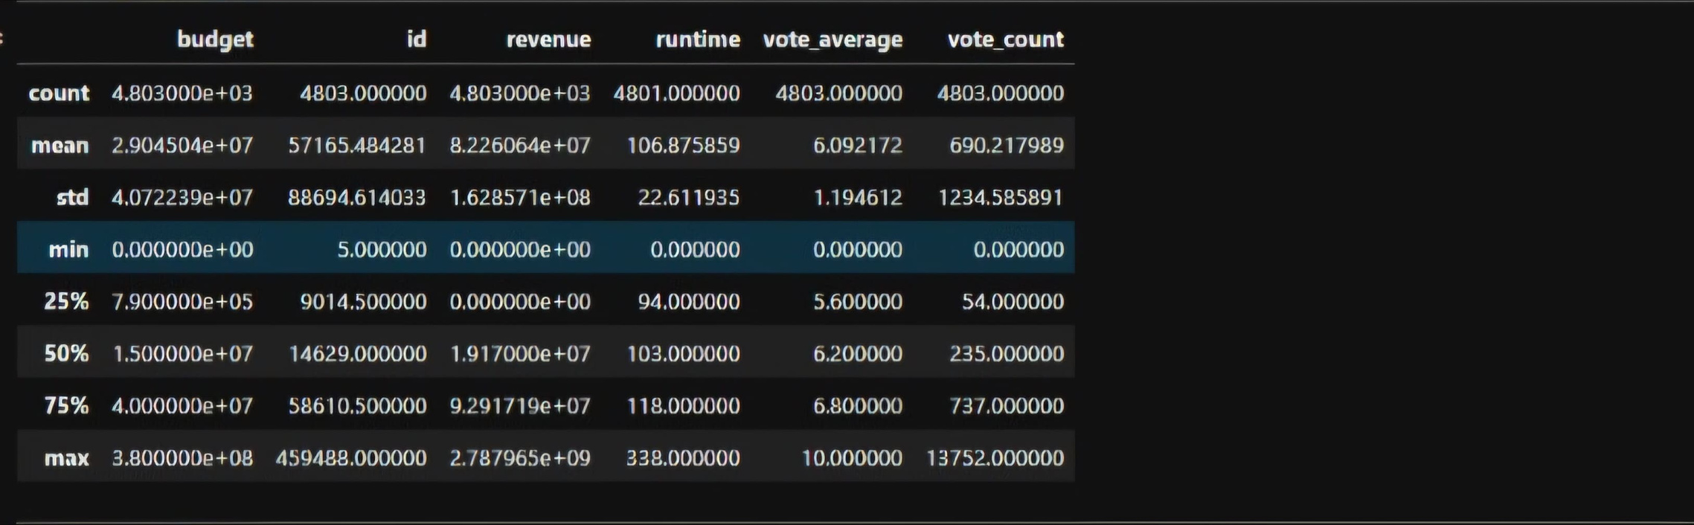
SNAPSHOT 2
MOVIES
5

Slide 6
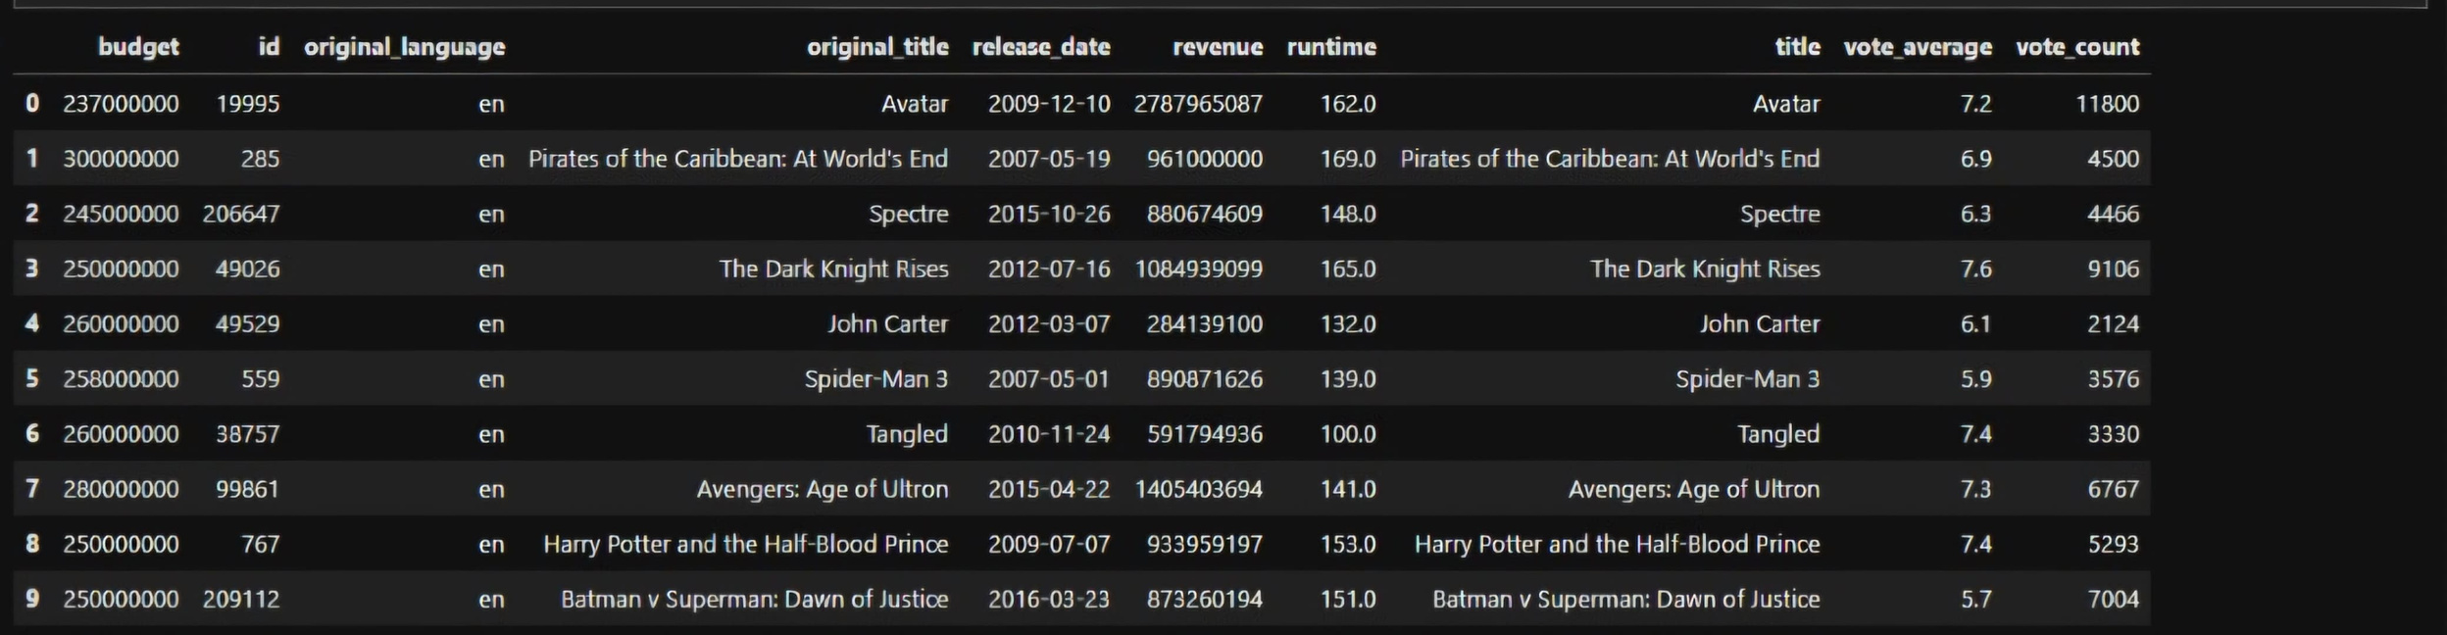
SNAPSHOT 3
MOVIES
6

Slide 7


DEMO
MOVIES
7

Slide 8


OUR REFERENCES
IMDB website
kaggle
MOVIE
8

Slide 9

QUESTIONS
MOVIE
9

Slide 10


THANK YOU
MOVIE
10

